Slide 1
Basic Statistics
NC S&T Parenterals
16 May 2018

Slide 2
Introduction
Statistics is widely used throughout AbbVie in S&T, R&D, Engineering, Manufacturing, Quality Assurance and other areas. This course discusses the most commonly used statistical methods, including:
Descriptive and graphical statistics
Hypothesis testing: t-test & z-test (means), chi-square test & F-test (standard deviations), and simple ANOVA
Confidence intervals - mean, standard deviation; cv/RSD
Correlation and regression
The focus will be on concepts and using software (Minitab) to perform the calculations
Prerequisites: Basic mathematics and algebra

Slide 3
Learning Objectives
Upon completion of this course, you will be able to:
Describe data by descriptive statistics and graphs
Understand the Normal distributions
Perform hypothesis tests for
Means (t-tests, one-way ANOVA)
Normality
Standard deviations (chi-square, F-test)
Calculate confidence intervals for
Means
Standard deviations
Review correlation and regression basics
Perform the above calculations using Minitab

Slide 4
Overview
Having a basic understanding of Applied Statistics will
help you turn your data into information;
allow you to determine the degree of confidence you have in drawing conclusions from your data;
help you meet regulatory expectations on the application of valid statistical methods.
Concepts
Statistics
Data
Standard Deviation
Confidence
Distributions
Percentages
Graphs
Mean

Slide 5
UNIT 1: DESCRIBING DATA
Types of Data
Populations and Samples
Summary Statistics
Graphical Analysis

Slide 6
Types of Data
Discrete data (Attributes data)
Pass / Fail
1 out of 100 cracked tablets
2/80 leaking containers
Number of defects per unit
2 extraneous material fibers on a tablet
3 CFUs (colony forming units) per ml of water
Continuous data (Variables data)
Length: 1.005 inches
pH: 6.1
99.3 % of label claim
Notes:
Things you count vs things you measure

Slide 7
Measurement Scales
Nominal
Red, Blue; Pass/Fail
Ordinal
A, B, C, D, F
Interval
45 deg F
Ratio
2.3 inches
Use Interval and Ratio scale data whenever possible
Notes:
Nominal = Name; Ordinal – data can be ranked, but no real difference Interval: arbitrary zero point; math can be done; absolute zero, ratio makes sense (2.3 vs 4.6 inches is 2X as long)

Slide 8


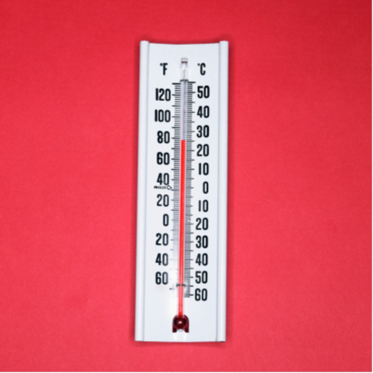
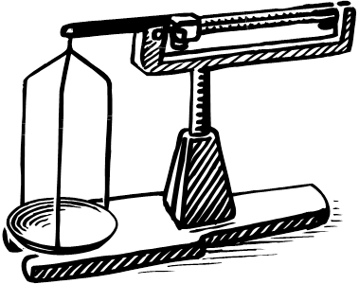
Scales of Measurement
Ordinal:
rank-ordered,
similar score intervals
Nominal:
Categorical,
Count/Rate,
Lowest scale
Interval:
fixed unit intervals of measure,
equal unit differences,
arbitrary “zero” value
Ratio:
fixed-unit intervals of measure, nonarbitrary, true “zero” value,
Highest scale

Slide 9
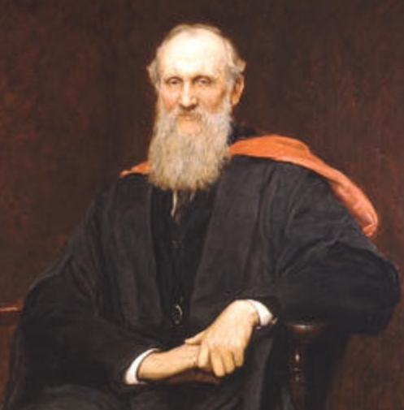
Variables Data is Preferred
"When you can measure what you are speaking about, and express it in numbers, you know something about it; but when you cannot measure it, when you cannot express it in numbers, your knowledge is of a meager and unsatisfactory kind.“ -- Lord Kelvin, 1883
If possible, don’t measure in percent defective.
Variables data is preferred
More descriptive
More statistical information and power
Fewer samples required for same statistical power

Slide 10
Population vs. Sample
A population is the set of all objects (people, etc.) one wants to make conclusions about. To do this, one selects a sample of objects: a subset of the population. By carefully examining the sample, one may make inferences about the larger population.
For example, if one wishes to determine the average height of adult women aged 20-29 in the U.S., it would be impractical to try to find all such women and ask or measure their heights. However, by taking a small but representative sample of such women, one may determine the average height of all young women quite closely. The matter of taking representative samples is the focus of sampling.
POPULATION of Adult Women, 20-29
Sample of Adult Women, 20-29

Slide 11
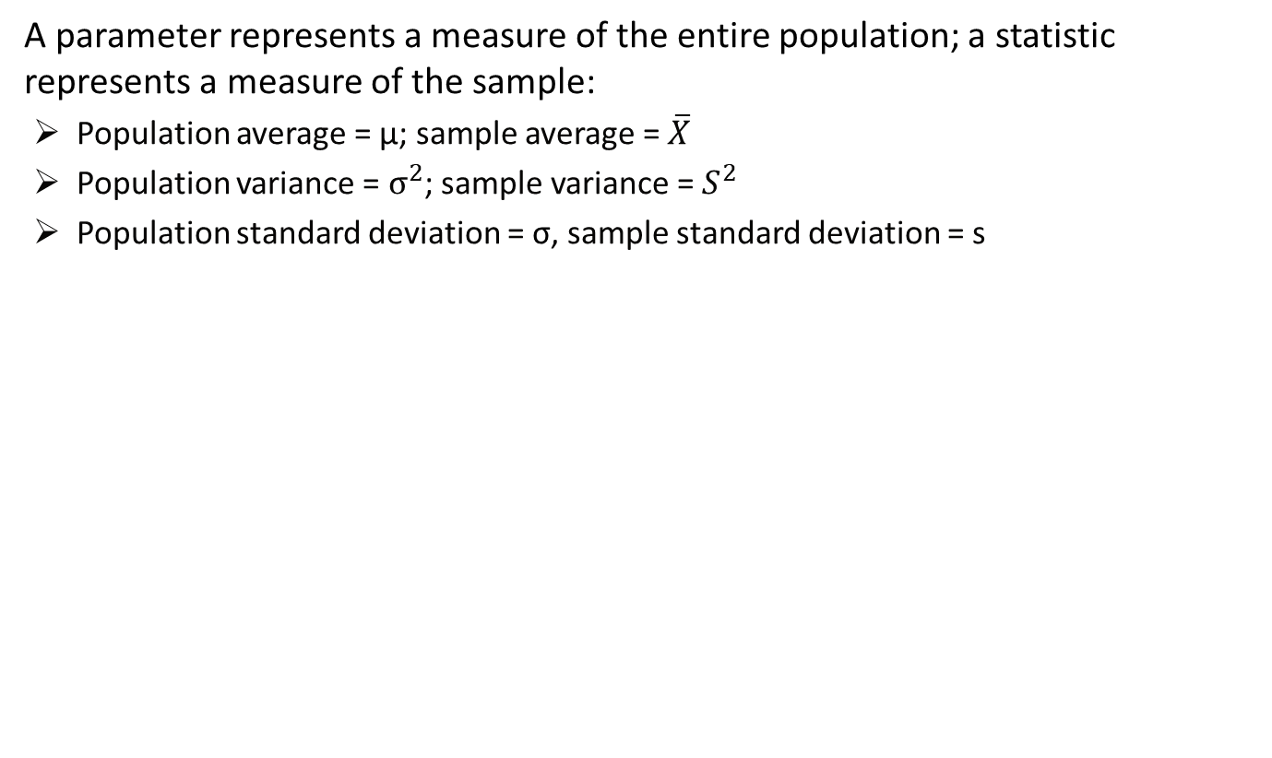
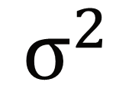
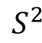
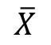
Parameter vs. Statistic
POPULATION
Sample
s
σ
µ

Slide 12
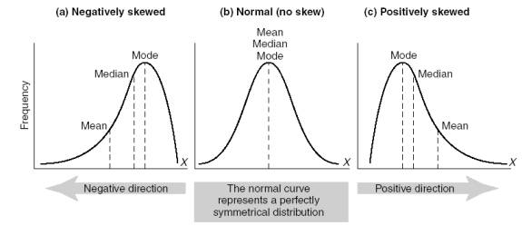
Common Summary Statistics
Measures of central tendency
Mean – center of the distribution
Median – middle 50%ile of the distribution
Mode – most commonly occurring value
Measures of dispersion (variation)
Range
Variance
Standard deviation
Measures of distribution shape
Skewness - measure of asymmetry
Negative value: skewed to the left
Positive value: skewed to the right.
Normal distribution: Skewness=0
Kurtosis – measure of distribution peak
Positive value: sharper peak than normal dist
Negative value: flatter peak than normal dist
Normal distribution: Kurtosis=0
Notes:
Ask where the median is often seen used (income; house prices) – insensitive to outliers

Slide 13


Descriptive vs. Inferential Statistics
Descriptive Statistics…
Describe a set of data (e.g., mean, standard deviation).
Allow us to describe the sample’s data as a whole, instead of by individual measures.
Describe a sample representative of a larger population we’ve collected the data from.
Inferential Statistics…
Generalize our findings beyond our sample to the population represented by that sample (e.g., t-test, F-test, correlation).
Describe the relationship of the sample to the population (e.g., different or alike).
The distinction between using descriptive vs. inferential statistics lies with the target of our description - the sample or its population it was drawn from.

Slide 14
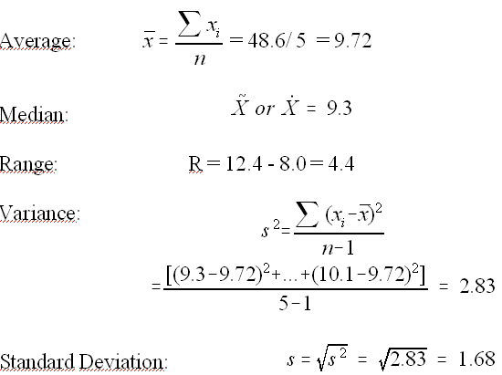
Summary Statistics
n=5 tubing samples using cyclohexanone solvent are tested for bond strength: 9.3, 8.8, 12.4, 8.0, 10.1
Note: use N instead of
n-1 if ALL data in population are available

Slide 15

Exercise: Summary Statistics
Diaphragm thickness for n=5 randomly selected IV bag ports
Calculate the
Mean
Median
Mode
Range
Variance
Standard deviation
9.7
10.0
10.4
14.1
10.7
Notes:
Mean 10.98; Median 10.4; Mode n/a; Range 14.1-9.7=4.4; Variance 3.20; Standard deviation 1.79

Slide 16
Summary Statistics
Use Minitab to calculate summary statistics for n=5 tubing samples bond strength: 9.3, 8.8, 12.4, 8.0, 10.1
Minitab: Stat / Basic Statistics / Display Descriptive Statistics
Descriptive Statistics: Bond
Variable N N* Mean SE Mean StDev Minimum Median Maximum Bond 5 0 9.720 0.752 1.681 8.000 9.300 12.400

Slide 17
Describing Data Graphically - Histogram
Temperature from AP32 water still over 6 weeks:
84, 76, 72, 71, 75, 69, 72, 64, 72, 70, 74, 84, 82, 75, 90, 140, 95, 92, 100, 150, 77, 86, 98, 68, 95, 100, 90, 85, 106, 78, 80, 74, 76, 80, 78, 70, 76, 77, 78, 87, 90, 68, 76, 78, 76, 80, 80, 75, 79, 78, 76, 75, 94, 82, 85, 74, 84, 74, 80, 77, 76, 78, 82, 82, 80, 75, 78, 75, 80, 72, 78, 80, 75, 82, 75, 80, 78, 75, 80, 75, 77, 82, 80, 78, 84, 78, 82, 80, 82, 68, 78, 70, 80, 80, 82, 82, 82, 72, 70, 80
Minitab: Graph / Histogram
Shape:
skewed to the right
Notes:
Note how histogram shows the 2 potential outliers.

Slide 18
Describing Data Graphically – Stem-and-Leaf Display
Temperature from AP32 water still over 6 weeks:
84, 76, 72, 71, 75, 69, 72, 64, 72, 70, 74, 84, 82, 75, 90, 140, 95, 92, 100, 150, 77, 86, 98, 68, 95, 100, 90, 85, 106, 78, 80, 74, 76, 80, 78, 70, 76, 77, 78, 87, 90, 68, 76, 78, 76, 80, 80, 75, 79, 78, 76, 75, 94, 82, 85, 74, 84, 74, 80, 77, 76, 78, 82, 82, 80, 75, 78, 75, 80, 72, 78, 80, 75, 82, 75, 80, 78, 75, 80, 75, 77, 82, 80, 78, 84, 78, 82, 80, 82, 68, 78, 70, 80, 80, 82, 82, 82, 72, 70, 80
Stem-and-Leaf Display 6 48889 7 000012222244445555555555666666677778888888888889 8 0000000000000002222222222244445567 9 00024558 10 006 11 12 13 14 0 15 0

Slide 19
Describing Data Graphically – Run Chart
Plot your data by time order Minitab: Graph / Scatterplot / Simple (Data View / Connect line)

Slide 20
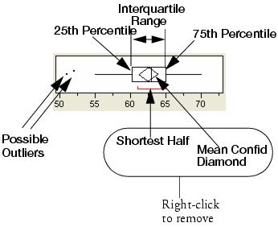
Boxplot
Whiskers: Data points inside 25/75%ile ± 1.5*Interquartile Range
Shortest half: Most dense 50% of data

Slide 21
Box plot – how to calculate
Note: for precise procedure, see A,B,Cs of Exploratory Data Analysis

Slide 22
Describing Data Graphically - Boxplot
Boxplots let you graphically see your data and identify unusual points
Example: burst strength for a sample of 18 package blisters:
9, 13, 10, 11, 10, 14, 12, 24, 11, 10, 12, 11, 10, 8, 13, 12, 10, 13
Minitab: Graph / Boxplot
Possible outlier
The box represents the middle 50% of the data. The “fences” give the smallest and largest data points within the approximate 99% limits. The outer point represents a potential outlier.
Notes:
Note potential outlier.

Slide 23
UNIT 2: THE NORMAL PROBABILITY DISTRIBUTION

Slide 24
Normal Distribution
Bell-shaped; Gaussian
34.13% 34.13%
13.60% 13.60%
2.14% 2.14%
0.13% 0.13%
-3σ -2σ -1σ μ +1σ +2σ +3σ
68.26%
95.46%
99.73%
• Average ± 1 sd will contain about 68% of the population • Average ± 2 sd will contain about 95% of the population • Average ± 3 sd will contain about 99.7% of the population

Slide 25
Normal Distribution Example: IQ Scores
IQ test scores are normally distributed with an average of μ=100 and a standard deviation of σ=15.
Approx. 68% of people score between 85 and 115 μ ± 1σ = (100 ± 15) = (85, 115)
Approx. 95% of people score between 70 and 130 μ ± 2σ = (100 ± 2*15) = (70, 130)
Approx. 99.7% of people score between 55 and 145 μ ± 3σ = (100 ± 3*15) = (55, 145)
Notes:
IQ = Intelligence Quotient

Slide 26
Normal Distribution IQ
Average ± 3 sd will contain about 99.7% of the population
IQ: n(µ = 100, σ=15)
100 ± 3x15 = (55, 145)
About 99.7% of all people have IQs between 55 and 145

Slide 27
Exercise: Normal Distribution
A review of several hundred lots of a pharmaceutical product showed a stable, in-control process for lot potency that averaged 99.8% of label claim with a standard deviation of 1.1%. Q1. Where should the potency for 95% of future lots be? Q2: Would these limits make good specification limits?
Notes:
1. 99.8 ±2 x 1.1 = (97.6, 102.0)
2. No; 5% of good lots would fail. 3-4.5 sigma is more commonly used.

Slide 28
Standard Normal z Distribution
Any normal distribution can be transformed into a standard normal distribution z with mean 0 and standard deviation 1 with the following formula:
Since we seldom know the true population mean and standard deviation, the sample average and standard deviation are often used as an approximation.

Slide 29
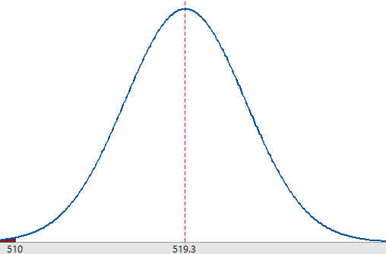
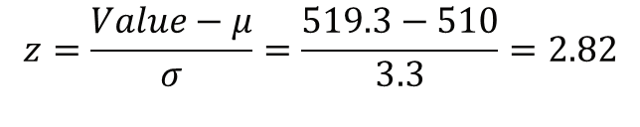
Standard Normal z Distribution
Example: Bottle fill weights are normally distributed with mean 519.3 mL and standard deviation 3.3 mL. Estimate the percent of bottles with a weight below the LSL of 510 mL.
From the z table, the probability that z >2.82 is 0.0024. The percent of bottles less than 510 mL is 0.0024 = 0.24%.

Slide 30
Standard Normal z Distribution
Example: 50 bottle fill weights have been collected for analysis. Determine if they are normally distributed before continuing further analysis.
Minitab: Stat/ Basic Statistics/ Normality Test

Slide 31
Standard Normal z Distribution
Example: Bottle fill weights are normally distributed with mean 519.3 mL and standard deviation 3.3 mL. Estimate the percent of bottles with a weight below the LSL of 510 mL.
Minitab: Calc / Probability Distributions / Normal
(Cumulative probability, Input constant = 510)
Normal with mean = 519.3 and standard deviation = 3.3
X P( X ≤ x )
510 0.0024148 p = 0.002415 that X < 510 mL

Slide 32
Standard Normal z Distribution
Alternate Minitab way to estimate normal probabilities: Minitab: Graph > Probability Distribution Plot > View Probability
p = 0.002415 that X < 510 mL

Slide 33
Central Limit Theorem
Population: 125,000 values from a 95-105 uniform rectangular distribution

Slide 34
Central Limit Theorem
Take 5,000 samples of size n from
95-105 rectangular distribution
Means of n=2 from uniform distribution
Means of n=5 from uniform distribution
Notes:
Note how distribution looks more “normal” as sample size increases

Slide 35
Central Limit Theorem
For any distribution with mean µ and standard deviation σ, regardless of the shape of the distribution, the averages of samples of size n as n gets large will be approximately normally distributed with mean µ and standard deviation σ/√n .
Example: The contents of n=5 cans per hour are weighed. The process has
a mean of 8.06 oz and standard deviation of 0.37 . What is the standard
deviation (most statisticians would use the phrase “standard error” here) of the averages of n=5 cans?
0
.
σ
37
0
.
σ
=
=
=
17
X
n
5

Slide 36
UNIT 3: Hypothesis Testing and Confidence Intervals for Means
Statistical decision making
Type 1 and Type 2 Errors
One-sample t-test and C.I. for the mean
Two-sample t-test and C.I. for differences between means
Paired t-test

Slide 37
Hypothesis Testing
An engineer for a medical device company thinks that a new solvent will yield stronger bonds than the current cyclohexanone. He randomly prepares 10 bonds using each solvent and tests them on an Instron tester. The results are shown below:
 | New Solvent A | Cylcohexanone
 | 9.2 | 9.3
 | 9.3 | 8.8
 | 9.5 | 12.4
 | 11.9 | 8.0
 | 9.3 | 10.1
 | 9.1 | 10.8
 | 9.8 | 10.7
 | 10.4 | 9.2
 | 9.7 | 9.3
 | 12.1 | 9.9
Average (xbar) | 10.03 | 9.85
Std dev (s) | 1.10 | 1.24
Is new solvent A better than Cyclohexanone?

Slide 38
Hypothesis Testing
The engineer decided that there was no improvement. He reformulated his new solvent, which he called solvent B, and collected 10 more samples of each. The results:
 | New Solvent B | Cylcohexanone
 | 10.6 | 9.8
 | 10.4 | 10.6
 | 11.3 | 9.4
 | 9.9 | 9.3
 | 11.9 | 10.5
 | 10.8 | 10.5
 | 13.4 | 12.0
 | 11.4 | 8.7
 | 10.9 | 9.8
 | 10.6 | 10.7
Average (xbar) | 11.1 | 10.1
Std dev (s) | 1.0 | 0.9
Is new solvent B better than Cyclohexanone?
Could the engineer have used the previous Cyclohexanone results instead of taking new data for Cyclohexanone?

Slide 39
Hypothesis Testing
Decisions, Decisions, Decisions
We are constantly faced with decisions to be made from data:
Is Method A better than Method B?
Is this lot worse than 0.4% defective?
Do the Instron and Ametek testers give the same average?
Is our new test instrument as precise as our old one?
Does spinwelder RPM affect seal integrity?
Is the coefficient of variation for this lot > 5%?
Has our complaint rate gone up?
Does drug potency decrease over stability time?

Slide 40
Risky Business
No matter how good we think we are...
We are going to make incorrect decisions
Statistical tools quantify and limit how often we make incorrect decisions
Courtroom Example:
 |  | Defendant is Actually
 |  | Not Guilty | Guilty
Jury Decides | Not Guilty(H₀) | Right! | Type II Error (β)
 | Guilty (H_{a}) | Type I Error (α) | Right!

Slide 41
Hypothesis Testing
Is New Solvent A stronger than Cyclohexanone?
 |  | Solvent A is actually
 |  | Not Stronger | Stronger
Engineer Decides Solvent A is | Not Stronger(H₀) | Right! | Type II Error (β)
 | Stronger (H_{a}) | Type I Error (α) | Right!
The Possibilities: 1. We can make a correct decision 2. We can make a Type I error 3. We can make a Type II error • Hypothesis testing controls/quantifies these errors • H_{0:} null hypothesis • H_{a:} alternate hypothesis

Slide 42
Type I and Type II Errors
Type I Error(α): Reject Ho when you shouldn’t Type II Error(β): Don’t reject Ho when you should
Type I Error Example A new automated tablet crush tester was being compared to the current manual method. There is really no difference between the two methods in force necessary to crush a tablet. To validate the new tester, 30 tablets are crushed by each method. However, a t-test wrongly indicated the automated tester gave a higher average than the current method and the validation was not passed. Type II Error Example A lot of Dial-a-Flo I.V. flow control devices has 1% plugged units. The acceptable quality limit is 0.4%. A QA inspector tests 32 units, but doesn’t find any plugged ones in his sample and the lot is released.

Slide 43
Type I and Type II Errors
Type I Error = α = Producer’s Risk: Reject Ho when you shouldn’t Type II Error = β = Consumer’s Risk: Don’t reject Ho when you should
Type I Error = Producer’s Risk Example
• Contract: 1.0% or fewer cosmetic defects acceptable • Lot ABC: Actually contained 0.5% cosmetic defects • Company sampled n=13 units, 2 defects found - Lot was rejected • Type I error made: lot should not have been rejected
Type II Error = Consumer’s Risk Example
• Contract: 1.0% or fewer cosmetic defects acceptable • Lot XYZ: Actually contained 2.6% cosmetic defects • Company sampled n=13 units, 0 defects found • Type II error made: lot should have been rejected

Slide 44
Type I and Type II Errors
Type I Error = α = Producer’s Risk: Reject Ho when you shouldn’t Type II Error = β = Consumer’s Risk: Don’t reject Ho when you should
Type I error (α) usually fixed at 0.05 (5%)
Different values should be used based on the circumstances
Type II error(β) usually chosen as 0.05 to 0.5
β = 0.05, 0.1, and 0.2 are commonly used
Type II error is controlled by using a suitable sample size
Trade-off: Smaller Type I error = larger Type II error

Slide 45
Common Statistical Hypothesis Tests
Test | Commonly Used for Testing
z-test | 1. Population mean versus a standard value, σ known 2. Population A mean versus population B mean, σ known 3. Population A % defective versus population B % defective
t-test | 1. Population mean versus a standard value - one-sample t-test, σ not known 2. Population A mean versus population B mean - two-sample t-test, σ not known 3. Regression analysis slope
Χ² test | 1. Population variance versus a standard value 2. Population A % defective versus population B % defective 3. Independence of factor A versus factor B for counts
F-test | 1. Population A variance versus population B variance 2. Used in ANOVA to compare more than two means

Slide 46
Hypothesis Testing Procedure
Set up the hypotheses
Null H₀
Alternate H_{a} Also called H₁
Set Type I α error (usually α=0.05)
Collect data
Compute test statistic
Compare test statistic to rejection criterion
Would test statistic occur with probability ≤ α if H₀ is true
Make decision to reject the null hypothesis or not
Reject H₀ if test statistic occurs with probability ≤ α if H₀ is true
Plot your data! Confirm assumptions Type II error best handled by choosing an appropriate sample size

Slide 47
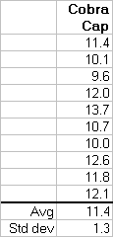
One Sample t-test
Purpose: Compare a sample mean with a standard value Assumptions: Data follow a Normal distribution; sigma unknown Example: Cobra Cap Pull Test The spec for the Cobra Cap says the mean pull should be ≤ 11 pounds.
H₀: µ ≤ 11 H_{a}: µ > 11

Slide 48
One Sample t-test
Example: Cobra Cap Pull Test The spec for the Cobra Cap says the mean pull should be ≤ 11 pounds. A sample of n=10 caps gave xbar = 11.4, s = 1.3. Let α=0.05.
H₀: µ ≤ 11 H_{a}: µ > 11
Test statistic:
If H₀ is true, t will have a t-distribution with (n-1) degrees of freedom. If H₀ is true, t will be less than 1.833 95% of the time. A t statistic of 0.97 is not unusual and does not exceed the critical value of 1.833. Do not reject H₀.

Slide 49
One Sample t-test - Minitab
Example: Cobra Cap Pull Test H₀: µ ≤ 11 H_{a}: µ > 11 (Let α=0.05)
Minitab: Stat / Basic Statistics / 1-Sample t
One-Sample T: Cobra Cap
Test of mu = 11 vs > 11
95% Lower Variable N Mean StDev SE Mean Bound T P
Cobra Cap 10 11.400 1.296 0.410 10.649 0.98 0.177
If p-value ≤α, reject H_{o}

Slide 50
p-values
Statistical computer programs calculate a probability p-value rather than finding the critical value. The p-value gives the probability of observing a result as extreme as was found in the data if the null hypothesis is true. Small p-values indicate that the results we observed were unlikely to have occurred by chance if the null hypothesis is true.
If the p-value is less than or equal to 0.05, there is a significant difference at the α=0.05 level. If the p-value is less than 0.01, the difference is significant at the α=0.01 level, etc.
Notes:
JMP uses slightly different nomenclature.

Slide 51
One-Sided or Two-Sided?
In the Cobra Cap example, we were only interested in determining if the mean was significantly greater than 11, so a one-tailed test was used. Often we will use two-tailed tests because we are just looking for a difference, either positive or negative. Two-sided tests are also more conservative. That is, the null hypothesis will not be rejected as often.
A two-tailed test only changes the critical region as follows:
H₀: µ = 11 H_{a}: µ ≠ 11 (Let α=0.05)
From before, t=0.97. Since the calculated t-value of 0.97 is not in the critical region, the null hypothesis is not rejected and no significant difference in the two methods’ average was shown. If you’re not sure whether you should use a one-sided or two-sided test, use the two-sided test.
Notes:
Discuss how 2-sided test is more conservative.

Slide 52
Confidence Interval For Mean
An hypothesis test just answers the question, is the null hypothesis reasonable? Is an average of 11 reasonable? It does not tell us where the mean actually is likely to be.
A (1-α)x100% Confidence Interval for the population mean based on a sample selected from a normal distribution is given by:
Sigma known:
Sigma unknown:
Assumes population is normally distributed, but the assumption is
not critical; the method is robust

Slide 53
Confidence Interval For Mean
Example: Cobra Cap Pull Test
The specification for the "Cobra Cap" says the mean pull value should be between 9 and 11 pounds. Suppose a sample of n = 10 is tested from cavity 9 to see if its average is greater than 11 pounds. Calculate a 95% (α=0.05) confidence interval based on the sample statistics: x-bar = 11.4, s=1.3
We can be 95% confident that the actual population mean for cavity 9 is between 10.47 and 12.33.

Slide 54
Confidence Interval For Mean - Minitab
Example: Cobra Cap Pull Test
Calculate a 95% (α=0.05) confidence interval the cavity 9 mean using the original data
Minitab: Stat / Basic Statistics / 1-Sample t (Options / Not equal)
We can be 95% confident that the actual population mean for cavity 9 is between 10.47 and 12.33.
One-Sample T: Cobra Cap
Test of mu = 11 vs not = 11
Variable N Mean StDev SE Mean 95% CI T P Cobra Cap 10 11.400 1.296 0.410 (10.473, 12.327) 0.98 0.355

Slide 55
What does a Confidence Interval do?
20 sets of samples, each of size n=10, from a n(µ=11, σ=1.4) distribution.
95 out of every 100 CIs will contain the true mean

Slide 56
Exercise: One Sample t-test
A powdered nutritional product is supposed to average 20 calories per ounce. 30 volunteers, using the scoops supplied with the product, each measured out enough powder to make one serving. The weight of the powder was converted to calories per ounce with the following results:
19.3 20.4 18.2 19.2 19.7 20.2 20.1 20.5 19.4 20.6 19.6 19.7 20.2 20.2 20.3 19.9 19.7 19.6 18.9 19.3 19.7 19.7 19.7 18.5 19.5 19.9 19.2 19.7 19.2 19.5
Avg=19.653, s.d. = 0.551
1. Does the powder average 20 calories per serving?
2. Construct a 95% confidence interval for the average.
3. What would you do next?
Notes:
Use Minitab for exercise.

Slide 57
Assumptions
Most classical statistical tests (t-test, F-test, etc.) have underlying assumptions:
The data are uncorrelated and independent from each other
The data are from a normal distribution
In addition, the standard two-sample t-test and ANOVA assumes: 3. Each population has the same standard deviation (homoscedastic)
Assumptions 2 and 3 are not usually critical because most classical statistical tests, especially those concerning means, are robust to non-normality and unequal standard deviations. Note: The F-test to compare standard deviations is not robust to non-normality.
Many statistical tests are sensitive to outliers, however. If you have a serious departure from the assumptions, or there are outliers present, you may wish to consider a non-parametric alternative to the classical tests covered in this class.

Slide 58
Two Sample t-test, equal variances
Purpose: Compare two population means Assumptions: Normality; same σ (for equal variances test) Example:
 | n | Mean | s
Solvent A | n₁=10 | xbar₁=10.03 | s₁=1.10
Cyclohexanone | n₂=10 | xbar₂=9.85 | s₂=1.24

Slide 59
Two Sample t-test, equal variances
 | n | Mean | s
Solvent A | n₁=10 | xbar₁=10.03 | s₁=1.10
Cyclohexanone | n₂=10 | xbar₂=9.85 | s₂=1.24

Slide 60
Two Sample t-test, unequal variances
Purpose: Compare two population means Assumptions: Normality; σ not the same for each population
If the two populations do not have similar standard deviations, the following t-test should be used:
Satterthwaite’s approximate degrees of freedom
It is not that big of a deal if you inadvertently use the equal variance t-test when the variances are not equal. The t-test is robust enough to still give a valid approximate result.

Slide 61
Two Sample t-test – Minitab
 | n | Mean | s
Solvent A | n₁=10 | xbar₁=10.03 | s₁=1.1
Cyclohexanone | n₂=10 | xbar₂=9.85 | s₂=1.24
Minitab: Stat / Basic Statistics / 2-Sample t (Options / Alternative / Greater than)
Two-Sample T-Test and CI: SolventA, Cyclohex1
Two-sample T for SolventA vs Cyclohex1
N Mean StDev SE Mean SolventA 10 10.03 1.10 0.35 Cyclohex1 10 9.85 1.24 0.39
Difference = mu (SolventA) - mu (Cyclohex1) Estimate for difference: 0.180 95% lower bound for difference: -0.732 T-Test of difference=0(vs >): T-Value=0.34 P-Value=0.368 DF=17
If p-value ≤α, reject H_{o}

Slide 62
Confidence Interval for Difference in Means
A two sample t-test determines if two populations have different means. The corresponding confidence interval estimates the difference in means. A 100*(1-α/2)% confidence interval for the difference in means is given by:
 | n | Mean | s
Solvent A | n₁=10 | xbar₁=10.03 | s₁=1.10
Cyclohexanone | n₂=10 | xbar₂=9.85 | s₂=1.24

Slide 63
C.I. for Difference in Means – Unequal Variances
If the standard deviations of the two groups are significantly different, then the confidence interval is given by:
Unless the standard deviations are substantially different, there is not much effect on the confidence interval.

Slide 64
Exercise: Two-Sample t-test
It was suspected that the Dial-a-Flo (DAF) welders were not consistent with each other for to average breaking torque. 8 samples were collected from welders #1 and #2. The samples were made from parts randomly selected from a tray of components and measured for torque. DAF Welder #1 DAF Welder #2
5 9 7 8 6 6 5 7 7 6 6 9 5 6 5 8 1. Is there a significant difference in welder means? 2. What is the 95% confidence interval for the difference in means?
Notes:
Use Minitab.

Slide 65
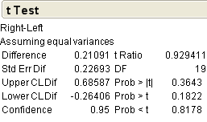
Paired data
To compare seal strength consistency from the left side of a package to the right side, 10 packages were selected and an instron test performed for one inch segments cut from the left and right sides of the package.
The engineer performed a two-sample t-test. Is there a difference between the left and right sides in average strength?
Pkg Left Right 1 2.3 2.5 2 1.7 1.9 3 3.2 3.2 4 1.9 2.4 5 2.3 2.6 6 1.9 2.0 7 1.5 1.6 8 2.9 3.3 9 2.4 2.3 10 1.9 2.4
Notes:
Problem: Data are not independent.

Slide 66
Paired t-test
Purpose: Compare the averages of two related/paired samples
Not realizing that the data are paired is a common mistake. The left and right package results are paired and not independent. For a paired t-test, calculate the difference for each pair, then perform a one-sample t-test on the differences to test for a mean difference of 0.
Pkg Left Right Diff 1 2.3 2.5 -0.2 2 1.7 1.9 -0.2 3 3.2 3.2 0.0 4 1.9 2.4 -0.5 5 2.3 2.6 -0.3 6 1.9 2.0 -0.1 7 1.5 1.6 -0.1 8 2.9 3.3 -0.4 9 2.4 2.3 +0.1 10 1.9 2.4 -0.5 Avg -0.22 Std dev 0.204

Slide 67
Paired t-test - Minitab
Minitab: Stat / Basic Statistics / Paired-t
Paired T-Test and CI: Left, Right
Paired T for Left - Right
N Mean StDev SE Mean Left 10 2.200 0.533 0.169 Right 10 2.420 0.533 0.169 Difference 10 -0.2200 0.2044 0.0646
95% CI for mean difference: (-0.3662, -0.0738)
T-Test of mean difference=0(vs not =0): T-Value=-3.40 P-Value=0.008

Slide 68
Exercise: pH Meter Comparison
For a diagnostic product, Production measures pH during manufacture, and QA measures it later before release. The following data represent pH from 15 lots of product. The QA release spec is 9.95 to 10.15.
1. Is there a difference between production and QA pH? 2. If there is a difference, what should be done?
Lot | Prod. pH | QA pH
1 | 10.07 | 10.06
2 | 10.07 | 10.09
3 | 10.02 | 10.03
4 | 10.06 | 10.08
5 | 10.05 | 10.04
6 | 10.04 | 10.05
7 | 10.11 | 10.12
8 | 10.05 | 10.07
9 | 10.04 | 10.04
10 | 10.08 | 10.08
11 | 10.07 | 10.08
12 | 10.10 | 10.11
13 | 10.09 | 10.10
14 | 10.07 | 10.07
15 | 10.08 | 10.08

Slide 69
UNIT 4: Hypothesis Tests for Normality and Confidence Intervals for Variation
Tests for Normality
One-sample chi-square test and C.I.
Two-sample F-test and C.I.
Multiple sample tests for variation

Slide 70
Testing for Normality
Statistical tests for variation can be sensitive to non-normality
Variables acceptance sampling, Cpk, Confidence for Reliability
Common ways to check for normality
Histogram
Normal probability plot
Ryan-Joiner test (not sensitive to data rounding) (Minitab)
Anderson-Darling test (Minitab)
Shapiro-Wilk W test (JMP)
Kolmogorov–Smirnov test (K–S test) (Minitab)
Chi-square goodness of fit test
Tests recommended for sample sizes n=20 to n=100
n<20 does not have good statistical power to detect non-normality
n>100 has too much statistical power
Will detect trivial departures from normality

Slide 71
Testing for Normality
Filler validation study
n=50 test results
Spec Limit: 505-535g - AQL: 0.4% - Collect a sample every 5 minutes over 4 hour run
Fill volume data: 519.4, 513.3, 519.9, 518.5, 522.4, 522.7, 522.0, 522.2, 516.2, 520.1, 523.1, 519.2 520.8, 518.8, 517.6, 516.8, 522.6, 522.0, 517.6, 513.5, 521.7, 519.9, 520.6, 522.6 515.3, 518.5, 513.7, 520.6, 517.1, 522.6, 513.9, 515.3, 518.6, 510.9, 521.3, 516.5 520.9, 523.0, 521.2, 519.4, 526.4, 525.0, 522.7, 519.6, 516.4, 519.9, 517.4, 519.6 515.8, 520.4

Slide 72
Testing for Normality
Minitab: Stat > Basic Statistics > Normality Test
The p-value > 0.100, which is greater than α=0.05.
Normality is not rejected.
Normal data will fall close to a straight line on the normal probability plot
Basic Statistics | QPP11-RDLCQA-0006EN Version 3 | Company Confidential © 2013
72

Slide 73
Testing for Normality
Minitab: Stat > Quality tools > Capability Sixpack > Normal

Slide 74
Normality Tests – Issues with Rounding
Rounding can cause many normality tests to fail
100 randomly generated normal observations, n(100, 2)
Unrounded Anderson-Darling: p=0.836

Slide 75
Normality Tests – Issues with Rounding
Rounding data can cause many normality tests to fail
100 randomly generated normal observations, n(100, 2)
Data rounded to 0 decimals: Anderson-Darling: p<0.005

Slide 76
Normality Tests – Issues with Rounding
Rounding data can cause many normality tests to fail
100 random normal observations, n(100, 2)
Data rounded to 0 decimals: Ryan-Joiner Test OK: p>0.100
Notes:
JMP does not have Ryan-Joiner test.

Slide 77
Dealing with non-normality
Determine why non-normality may exist
More than one population in the data? Cavities, fill stations, etc.
Drift or shift over time during data collection?
Overly-rounded data?
Poor measurement resolution, truncated data, rounding
Outliers?
Too much data?
Actual non-normal distribution?
Often the case with time to failure, failure forces, counted data
Most statistical methods for means are robust
t-test, ANOVA, regression line coefficients
Transform data to be normal
Use statistical method not sensitive to normality
Non-parametric tests
Mann-Whitney instead of two-sample t-test
Levene’s test instead of F-test for variances

Slide 78
Data Transformations
Concept: Transform data mathematically to be normal
Ladder of Powers
Box Cox transformation
Johnson transformation
Pearson transformation

Slide 79
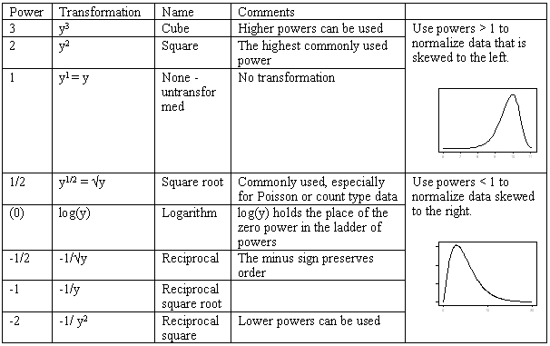
Data Transformations – Ladder of Powers

Slide 80
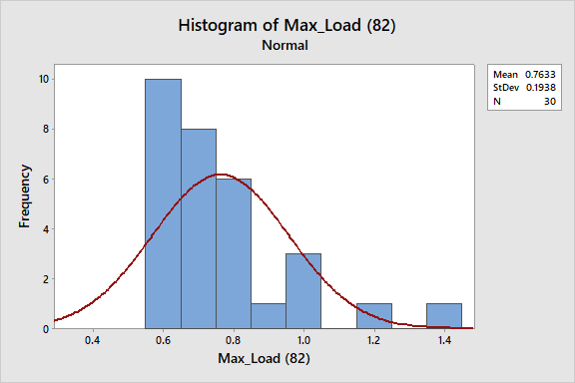
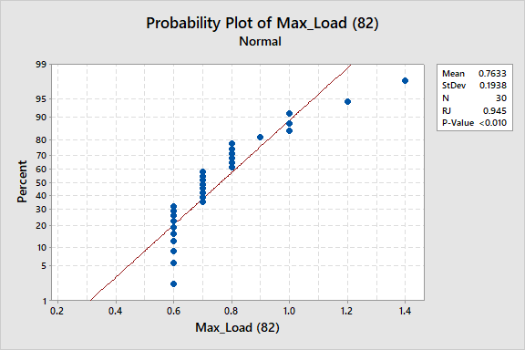
Data Transformations – Ladder of Powers
Histogram for Maximum Load (N): Skewed to the right – try a square root transformation

Slide 81
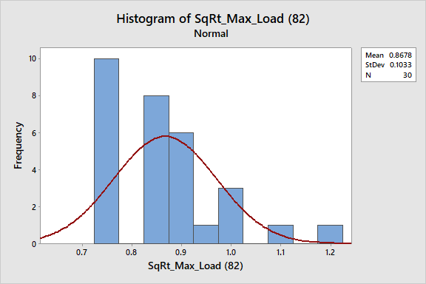
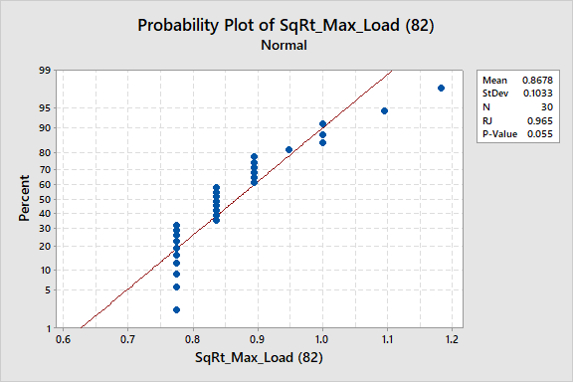
Data Transformations – Ladder of Powers
Square Root of Maximum Load (N): Still skewed to the right – try something stronger up the ladder of powers: a log transformation

Slide 82
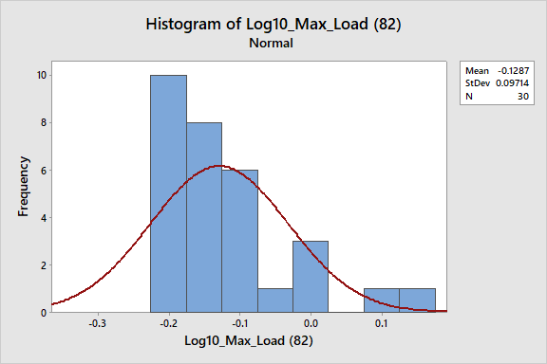
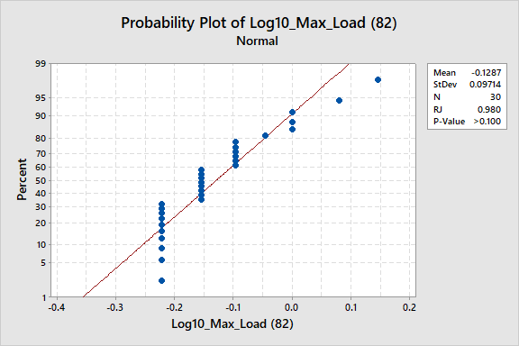
Data Transformations – Ladder of Powers
Log10 of Maximum Load

Slide 83
Box Cox Transformation
The Box-Cox transformation can help select the correct power
Defined in Minitab as: T(Y) = Y^{λ}
Y is the variable of interest
T(Y) is the transformed variable
λ is the transformation parameter
λ=2 ➔ Y²
λ=1 ➔ no transformation
λ=0.5 ➔ sqrt Y
λ=0 ➔ ln Y
λ=-0.5 ➔ 1/sqrt Y
λ=-1 ➔ 1/y , etc.
Optimal λ found by maximizing linear correlation coefficient r of normal probability plot
The more linear the probability plot, the better a normal distribution fits the data

Slide 84
Box Cox Transformation Example
Minitab: Stat > Control Charts > Box-Cox Transformation > Subgroup size 30
Log transformation (Lambda=0) is optimal to normalize Max Load data

Slide 85
Chi-square Test for Variance / Std. Dev.
Purpose: Compare the variance or std. dev. with a specified value Assumptions: Normality, independence
Example: Tester Validation The sensitivity spec for a disposable transducer is 5.00 ± 0.05 uV/V/mmHg. The 4:1 rule says the measurement error uncertainty ratio [defined as ±2σ/(spec range)], should be less than one quarter of the spec range. This means we want 4σ < 0.1/4, or σ < 0.00625. To test the repeatability error of our tester, one unit was measured 15 times:
Data: 4.975, 4.981, 4.978, 4.980, 4.974, 4.977, 4.984, 4.979, 4.976, 4.976, 4.980, 4.973, 4.976, 4.979, 4.977 Avg = 4.978, s = 0.00289

Slide 86
Confidence Interval for Variance / Standard Deviation
A (1-α)x100% two-sided confidence interval for the variance is
Example: Transpac II Sensitivity data: Avg: 4.978, s.d. = 0.00289, n=15
A 95% confidence interval (α=0.05) for the variance is given by:
Taking the square root gives a 95% confidence interval for the standard deviation of (.0021, .0046).

Slide 87
Confidence Interval and Test for Std. Dev. - Minitab
Minitab: Stat / Basic Statistics / 1 Variance (Options / Alternative / Less than)
Test and CI for One Standard Deviation: Sensitivity
Null hypothesis Sigma = 0.00625 Alternative hypothesis Sigma = < 0.00625
The standard method is only for the normal distribution. The Bonett method is for any continuous distribution.
Variable N StDev Variance Sensitivity 15 0.00289 0.000008
95% One-Sided Confidence Intervals Upper Bound Upper Bound Variable Method for StDev for Variance Sensitivity Standard 0.00423 0.000018 Bonett 0.00436 0.000019
Tests Variable Method Chi-Square DF P-Value Sensitivity Standard 3.00 14.00 0.001 Bonett — — 0.002
Note: Bonett method uses the sample kurtosis in the formula

Slide 88
Confidence Interval for Coefficient of Variation (RSD)
CV = RSD = Std Dev / Mean
An approximate C.I. for the CV is the C.I. for the standard deviation divided by the sample mean. The approximation is accurate because most of the variability in the CV is due to the standard deviation, not the mean. The approximation is accurate for CV’s less than 25%.
Example: Test Method Validation In order to establish a new test method’s repeatability, n=9 assays were conducted on a single sample of product. The results were n=9, avg=98.76, s=1.23 cv = 1.23/98.76 = 1.24%
95% CI for σ:
Approx. 95% CI for CV=(0.83/98.76, 2.36/98.76) = (0.84%, 2.39%)

Slide 89
Exercise: Confidence Interval for Standard Deviation
A chemical standard was sampled and tested 10 separate times on an HPLC with the following results:
Mean: 99.92
Standard deviation: 0.56
Calculate a 95% confidence interval for the
Variance
Standard deviation
Do you feel confident the Coefficient of Variation (also called Relative Standard Deviation) is ≤2.0% ?
Notes:
Use Minitab or do by calculator.

Slide 90
Exercise: Confidence Interval for CV (RSD)
Exercise: Field Test for Diagnostics Product CV The label claim for CV for a particular diagnostic product is 5%. After receiving several complaints about poor repeatability from the field, n=24 kits were obtained from customer inventories and tested per the standard Q.A. release test with the following Rate results: 19.4 20.3 21.7 17.4 20.1 20.4 19.7 21.0 20.3 20.0 20.8 20.9 18.4 20.1 23.0 20.0 19.5 19.2 19.6 21.9 19.6 20.7 19.7 19.3
n=24, Mean=20.126, s=1.148
Can we be confident that the tested product meets the CV label claim of 5%?

Slide 91
F-test for Comparing Two Variances / Std. Deviations
Purpose: Compare the std. devs. of two independent samples Example: Heparin Activity To compare the consistency of a new method of applying heparin for coated catheters, 10 catheters were produced with the new method and 10 with the current method.
New method: 32, 31, 33, 32, 29, 30, 32, 33, 31, 34; avg=31.7, s=1.494 Current meth: 37, 30, 34, 36, 31, 38, 34, 29, 35, 29; avg=33.3, s=3.335
Is there a difference in consistency between the two methods?
H_{o}: Standard deviations are equal H_{a}: Standard deviations are not equal

Slide 92
F-test for Comparing Two Standard Deviations
New method: 32, 31, 33, 32, 29, 30, 32, 33, 31, 34; avg=31.7, s=1.494 Current meth: 37, 30, 34, 36, 31, 38, 34, 29, 35, 29; avg=33.3, s=3.335

Slide 93
Minitab: F-Test to Compare Variances / Std. Deviations
Minitab: Stat / Basic Statistics / 2 Variances -- or-- Stat / ANOVA / Test for Equal Variances
F-test: Reject equal variances
Levene’s test not sensitive to non-normality

Slide 94
Exercise: F-Test
An engineering study for a new induction sealing process for containers for capsules and tablets was performed. 10 samples from the current process and new process were tested for water vapor permeability.
 | Current | Induction
 | 1.904 | 3.692
 | 4.590 | 6.497
 | 6.685 | 5.232
 | 4.492 | 6.409
 | 11.617 | 7.648
 | 3.832 | 6.537
 | 6.112 | 6.559
 | 5.316 | 4.324
 | 4.348 | 4.922
 | 4.682 | 6.479
Avg | 5.358 | 5.830
s | 2.551 | 1.227
Q. Is there any difference in mean or standard deviation between the two processes?

Slide 95
F-Max (Hartley) Test to Compare Several Std Devs
Purpose: Compare std. deviations of three or more groups Assumptions: Normality, equal n per group
Example: 30 samples from three compensation machines for a disposable pressure transducer were followed through production with the following final test sensitivity results: n Avg s.d. Machine #1 30 5.014 0.023 Machine #2 30 5.012 0.011 Machine #3 30 5.017 0.014
Compare Fmax with the table critical value for r=3 groups and 29 df. The table does not include 29 df, but the critical value for α=0.05 and 30 df is 2.4. Since the calculated Fmax is much greater than this, we conclude the compensation machines do not all have the same standard deviation.

Slide 96
Other Tests to Compare Several Standard Deviations
There are several tests to compare two or more std. devs.
F-Max / Hartley Test
Easy to use and manually calculate
As sensitive to non-normality as the F-test
Bartlett’s test (in Minitab under ANOVA)
Sensitive to non-normality
Levene’s test (in Minitab under ANOVA)
Modification called Brown-Forsythe test
Not sensitive to non-normality
Best overall test to compare two or more standard deviations
Notes:
Levene’s / Brown-Forsythe test is the recommended test.

Slide 97
UNIT 5: Analysis of Variance (ANOVA)
One-way ANOVA to compare the means of several populations

Slide 98
One-Way Analysis of Variance (ANOVA)
Purpose: Compare averages of three or more groups Assumptions: Normality within group; equal variances for each group To see if four Dial-a-Flo ultrasonic welders were consistent, 8 samples from each welder were made at the same time from parts randomly selected from a tray of components and then randomly tested.
H₀: All four averages are equal; i.e., µ₁= µ₂= µ₃= µ₄ H_{a}: One or more of the averages are not equal to the others
Are the welders consistent with respect to mean torque?

Slide 99
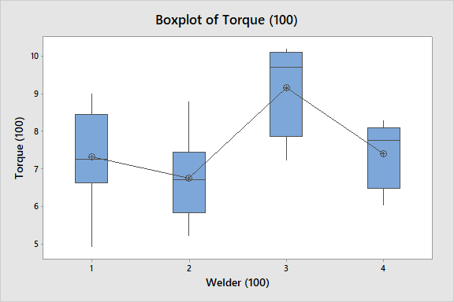
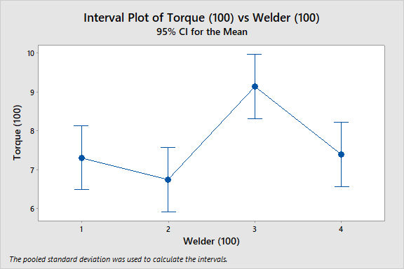
Minitab: One-Way Analysis of Variance (ANOVA)
Minitab: Stat / Anova / One-Way / (Graphs / Boxplot or Interval Plot)

Slide 100
One-Way Analysis of Variance (ANOVA)
To see if the means are significantly different, the within-welder variation will be compared to the between-welder variation.
Since F exceeds the critical value of 2.95, reject H_{o} of equal means.

Slide 101
Minitab: One-Way Analysis of Variance (ANOVA)
Minitab: Stat / Anova / One-Way /
Analysis of Variance
Source DF Adj SS Adj MS F-Value P-Value
Welder (100) 3 25.89 8.630 6.70 0.002
Error 28 36.07 1.288
Total 31 61.96
Model Summary
S R-sq R-sq(adj) R-sq(pred)
1.13498 41.79% 35.55% 23.97%
Welder
(100) N Mean StDev 95% CI
1 8 7.313 1.307 (6.491, 8.134)
2 8 6.750 1.121 (5.928, 7.572)
3 8 9.150 1.198 (8.328, 9.972)
4 8 7.400 0.868 (6.578, 8.222)
Pooled StDev = 1.13498

Slide 102
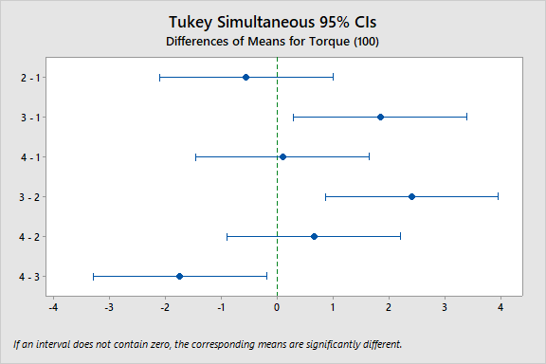
Minitab: One-Way Analysis of Variance (ANOVA)
Minitab: Stat / Anova / One-Way /
Tukey Pairwise Comparisons
Grouping Information Using the Tukey Method and 95% Confidence
Welder
(100) N Mean Grouping
3 8 9.150 A
4 8 7.400 B
1 8 7.313 B
2 8 6.750 B

Slide 103
One-Way Analysis of Variance (ANOVA) Table

Slide 104
UNIT 6: Correlation & Regression

Slide 105
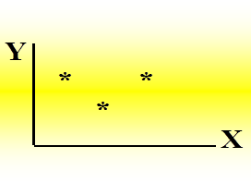
Correlation
Correlation is a statistical technique used to determine the degree to which two variables are related
Estimate the relationship between two quantitative variables without being able to infer causal relationships
Independent variable (X) assessed vs. Dependent variable (Y)
Assessed on a rectangular coordinate scatterplot

Slide 106
Correlation
The value of a correlation ranges from +1 to -1
Correlation = +1 indicates a strong positive relationship between variables X & Y; as X increases, Y displays a corresponding increase
Correlation = -1 indicates a strong negative relationship between variables X & Y; as X increases, Y displays a corresponding decrease or as X decreases, Y displays a corresponding increase
Correlation = 0 indicates no relationship between variables X & Y
Correlation coefficient referred to as “r”
Pearson product moment “r” – measures strength of association of two quantitative variables
Spearman Rank “r_{s}” – measures strength of association of:
Two quantitative variables
Two qualitative, ordinal variables
One quantitative variable and one qualitative, ordinal variable

Slide 107
Correlation: Example Ranges between X & Y
The value of r ranges between ( -1) and ( +1)
The value of r denotes the strength of the association as illustrated by the following diagram.
These ranges might not be appropriate for all variables. Process and scientific judgment should also be considered.
strong
intermediate
weak
weak
intermediate
strong
-1
-0.75
-0.25
0
0.25
0.75
1
indirect
Direct
perfect correlation
perfect correlation
no relation

Slide 108
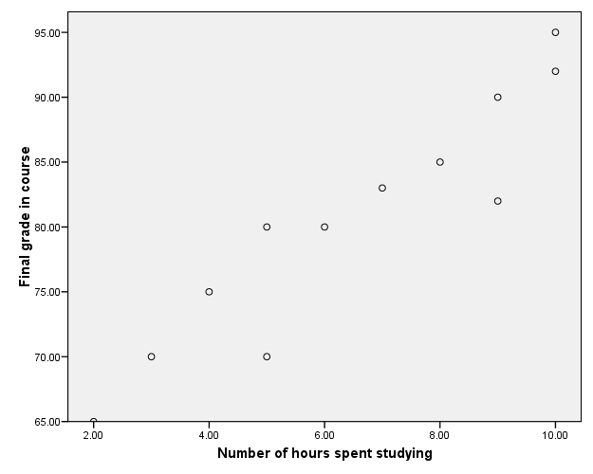
Correlation – Positive relationship between variables

Slide 109
Correlation - Negative relationship between variables
Reliability
Age of Car

Slide 110
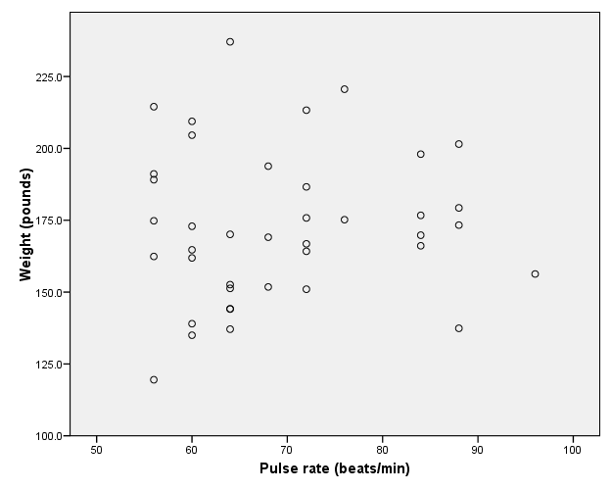
Correlation – No relationship between variables

Slide 111
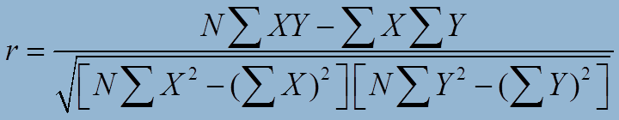
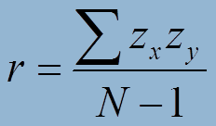
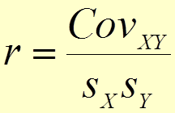
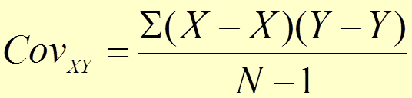
Correlation – Formulas for Pearson r
Computational(Raw Score) method
Z-score method
Covariance method
where

Slide 112
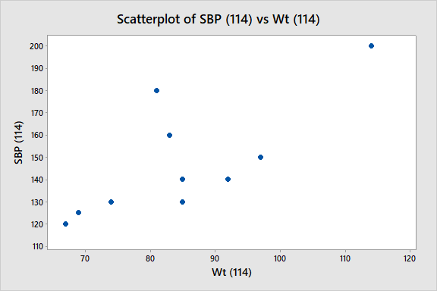
Correlation – Example of Weight vs. Systolic Blood Pressure
Weight (kg) | 67 | 69 | 85 | 83 | 74 | 81 | 97 | 92 | 114 | 85
SBP (mHg) | 120 | 125 | 140 | 160 | 130 | 180 | 150 | 140 | 200 | 130
Pearson correlation of Weight and SBP = 0.740
P-Value = 0.014
Spearman rho for Weight and SBP = 0.667
P-Value = 0.035

Slide 113
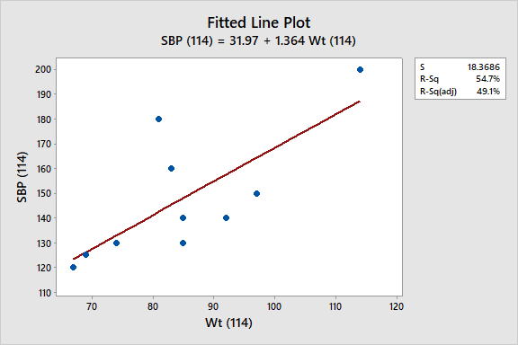
Correlation and Regression
Correlation describes the strength of a linear relationship between two variables
Linear means “straight line”
Regression tells us how to draw the straight line described by the correlation

Slide 114
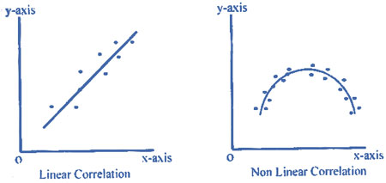
Simple Linear Regression
Goal is to:
describe the relationship between the dependent variable (Y) and a single independent variable (X)
predict variable Y using variable X
identify how Y changes as a function of changes in X
Notes:
Simple linear regression assumes that the dependent variable has a linear relationship with the independent variable.
The simplest diagnostic plot for this situation is a scatter plot.
If the relationship is not linear, you may still have options. However, this is an advanced topic, and you should consult a statistician.

Slide 115
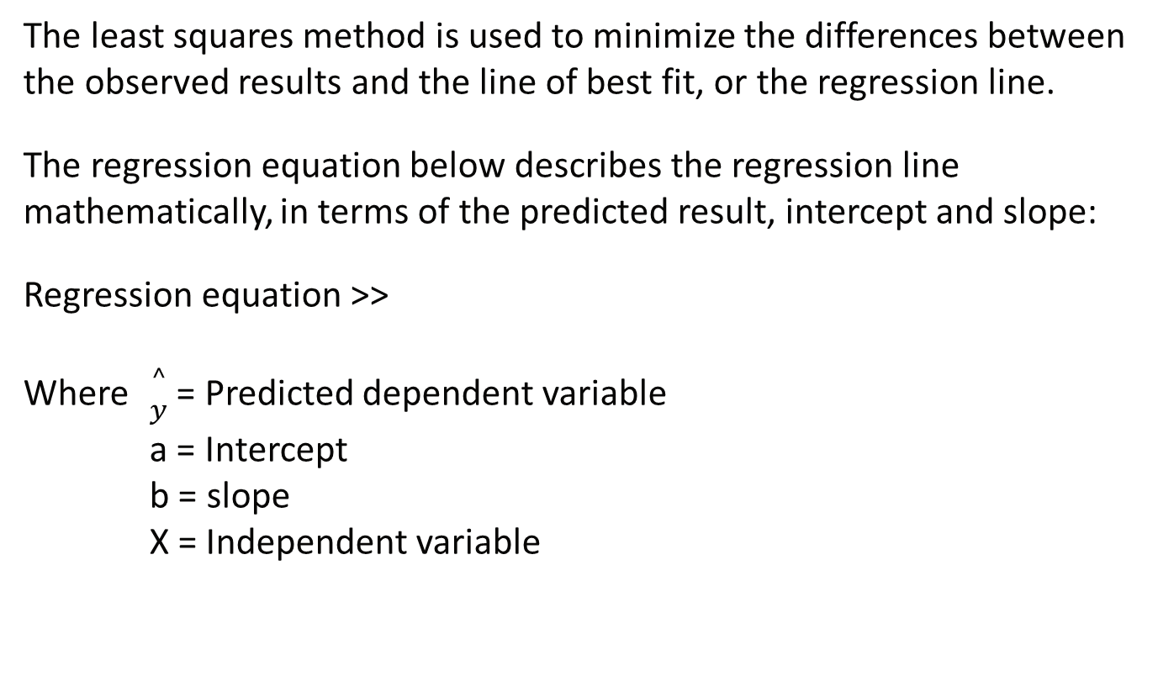
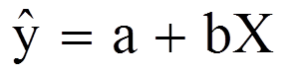
Regression

Slide 116
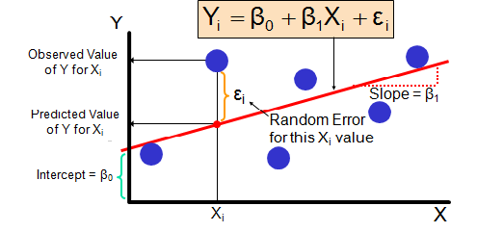
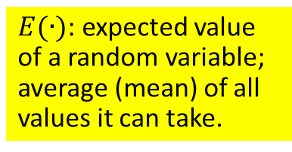
Regression Model
Observation index

Slide 117
Parameter Interpretation
β₀ is the intercept: mean systolic blood pressure when weight is zero.
β₁ is the slope: change in mean systolic blood pressure for a unit change in weight.
Note: The intercept may not have a practical interpretation in case where X can not take a zero value.

Slide 118
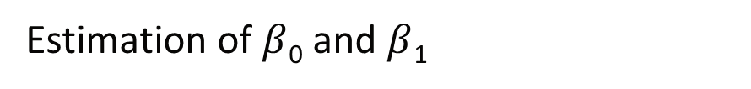
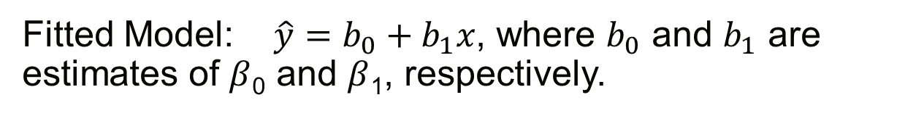
Terminology:

Slide 119
How can we draw a reasonable line through the points?
The residuals should be as small as possible.
The residuals should add up to 0.
However, there are different ways to do this. In this session, we will cover the usual least squares criterion.

Slide 120
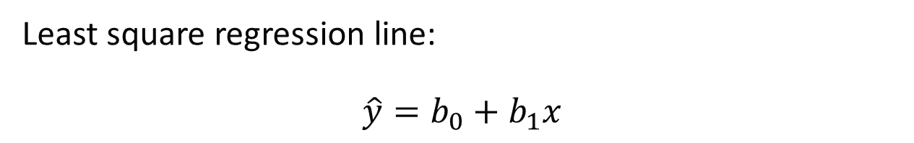
Least Squares Method: Find the values of b₀ and b₁ that minimize SSE.
Those values are called the “least squares estimates” of b₀ and b₁:

Slide 121
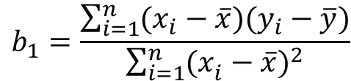
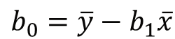
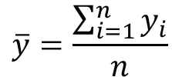
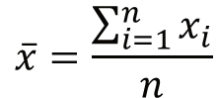
Least squares estimates
where

Slide 122
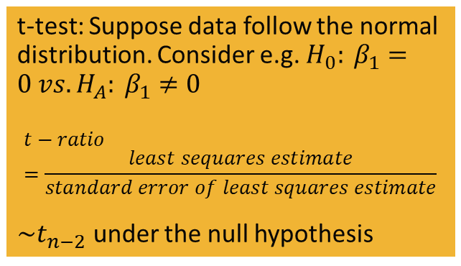
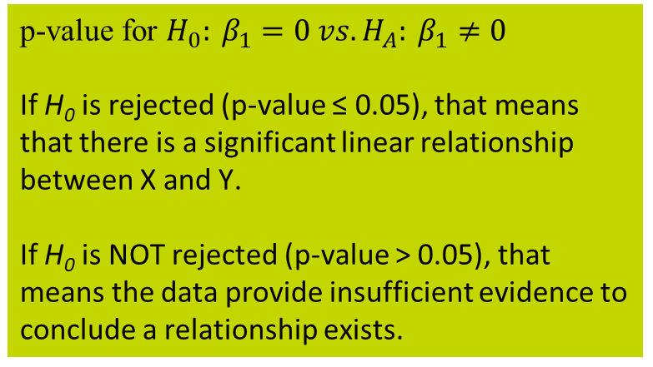
Example: Weight vs. Systolic Blood Pressure
Regression Analysis: SBP (114) versus Wt (114)
Analysis of Variance
Source DF Adj SS Adj MS F-Value P-Value
Regression 1 3263.24 3263.24 9.67 0.014
Wt (114) 1 3263.24 3263.24 9.67 0.014
Error 8 2699.26 337.41
Lack-of-Fit 7 2649.26 378.47 7.57 0.273
Pure Error 1 50.00 50.00
Total 9 5962.50
Model Summary
S R-sq R-sq(adj) R-sq(pred)
18.3686 54.73% 49.07% 29.64%
Coefficients
Term Coef SE Coef T-Value P-Value VIF
Constant 32.0 37.6 0.85 0.420
Wt (114) 1.364 0.439 3.11 0.014 1.00
Regression Equation
SBP (114) = 32.0 + 1.364 Wt (114)
Fits and Diagnostics for Unusual Observations
Std
Obs SBP (114) Fit Resid Resid
6 180.00 142.45 37.55 2.16 R
R Large residual
Durbin-Watson Statistic = 2.60853
b₀
b₁

Slide 123
Remarks
When b₁ = 0, the value of X has no influence on the value of Y.
b₁ > 0 : positive relationship between the variables
b₁ < 0 : negative relationship
The slope b₁ of the prediction equation tells us the direction of the association between the two variables
Positive b₁ : Slope upward
Negative b₁ : Slope downward
The slope does not tell us the strength of the association. It depends on the units and can be made arbitrarily small or large by choice of units.

Slide 124
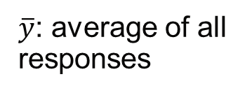
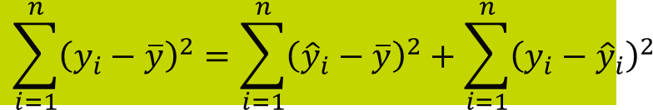
Assessing the Fit of the Regression
Decomposition of Variability in Response
SST
SSR
SSE
SST (total sum of squares): total variation in the y’s
SSR (regression sum of squares): variation that can be “explained” by the model
SSE (error sum of squares): “unexplained” variation

Slide 125
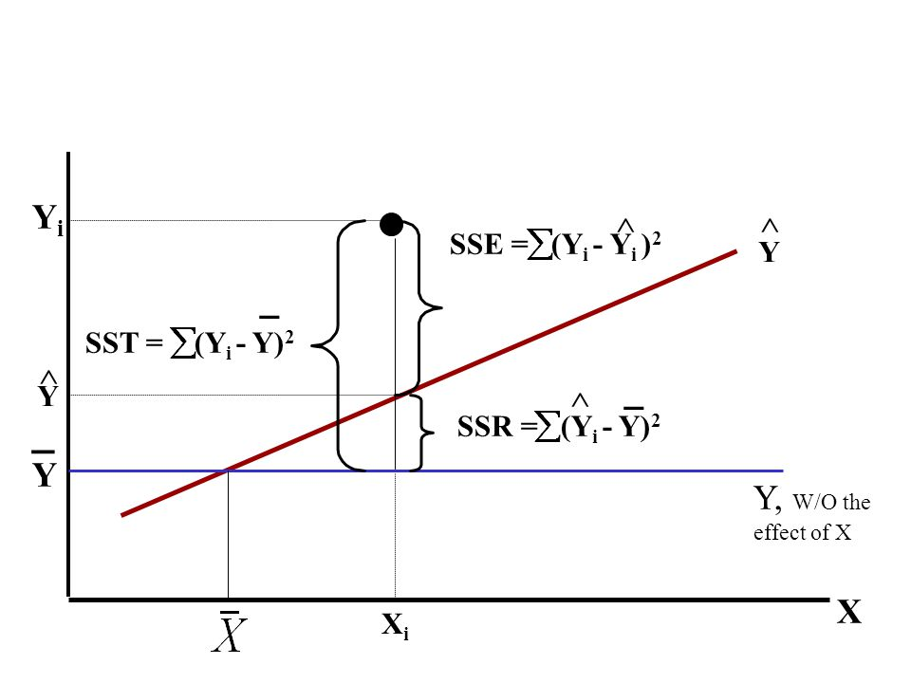
Assessing the Fit of the Regression

Slide 126
The “Coefficient of Determination”: R²
Note: the larger the value of R², the better the fit of the regression.

Slide 127
An alternative measure of fit: F statistic
Null hypothesis: The fit of the intercept-only model and your model are equal.
Alternative hypothesis: The fit of the intercept-only model is significantly reduced compared to your model.
Signal-to-noise ratio.
Large F (small p-value)
→ MSR much larger than MSE
→ The fit of the intercept-only model is significantly reduced compared to your model.

Slide 128
Analysis of Variance
Source DF Sum of Mean F Ratio Prob>F
squares squares
---------------------------------------------------------------------------------------------
Model 1 SSR MSR=SSR/DF MSR/MSE X.XXX
Error n-2 SSE MSE=SSE/DF
---------------------------------------------------------------------------------------------
Total n-1 SST
Analysis of Variance
Source DF SS MS F P
Regression 1 3263.24 3263.24 9.67 0.014
Error 8 2699.26 337.41
Total 9 5962.50
p-value < 0.05 → Conclusion?

Slide 129
Multiple Linear Regression Model
Goal: Multiple regression is a generalization of simple linear regression wherein the model relates the single dependent variable Y simultaneously to several, say K, independent variables X₁ , X₂ , …., X_{K}.

Slide 130

Multiple Linear Regression Model
In general, the multiple linear regression model allows any number of independent variables
or
Note: The “simple linear model” is a special case (K=1).

Slide 131
Fitted Model (Prediction Equation)

Slide 132
Terminology

Slide 133

Inferences
Null hypothesis: The fit of the intercept-only model and your model are equal.
Alternative hypothesis: The fit of the intercept-only model is significantly reduced compared to your model.

Slide 134
Inferences
If H₀ is not rejected, then the conclusion is that the set of independent variables is of little or no use in explaining the variation in the dependent variable Y.
If H₀ is rejected, then at least one of the independent variables helps explain the variation in Y. But we don’t know which one at this point.

Slide 135
Analysis of Variance
Source DF Sum of Mean F Ratio Prob>F
squares squares
-------------------------------------------------------------------------------------
Model K SSR MSR=SSR/DF MSR/MSE
Error n-K-1 SSE MSE=SSE/DF
------------------------------------------------------------------------------------
Total n-1 SST
Measure of fit: F statistic
Signal-to-noise ratio.
Large F (small p-value)
→ MSR much larger than MSE
→ The fit of the intercept-only model is significantly reduced compared to your model.

Slide 136
Inferences
If you fail to reject H₀ (p-value for F test > 0.05) Stop and propose new model!!!
(maybe new independent variables)
If you reject H₀ (p-value ≤ 0.05) individual t-tests for each independent variable to see which independent variable is important

Slide 137

Example: HCV
Dependent variable
Independent variables

Slide 138
Example: HCV
Analysis of Variance
Source DF Seq SS Contribution Adj SS Adj MS F-Value P-Value
Regression 4 9.39000 98.37% 9.39000 2.34750 90.61 0.000
Flow_Rate (140) 1 1.12500 11.79% 1.12500 1.12500 43.42 0.001
Column_Temp (140) 1 8.00000 83.81% 8.00000 8.00000 308.77 0.000
Initial_Pct_B (140) 1 0.24500 2.57% 0.24500 0.24500 9.46 0.022
Pct_TFA (140) 1 0.02000 0.21% 0.02000 0.02000 0.77 0.413
Error 6 0.15545 1.63% 0.15545 0.02591
Lack-of-Fit 4 0.15545 1.63% 0.15545 0.03886 * *
Pure Error 2 0.00000 0.00% 0.00000 0.00000
Total 10 9.54545 100.00%
Model Summary
S R-sq R-sq(adj) PRESS R-sq(pred)
0.160963 98.37% 97.29% 0.546089 94.28%
Coefficients
Term Coef SE Coef 95% CI T-Value P-Value VIF
Constant 17.14 1.71 ( 12.95, 21.33) 10.00 0.000
Flow_Rate (140) -3.750 0.569 ( -5.143, -2.357) -6.59 0.001 1.00
Column_Temp (140) -0.2000 0.0114 (-0.2279, -0.1721) -17.57 0.000 1.00
Initial_Pct_B (140) 0.0875 0.0285 ( 0.0179, 0.1571) 3.08 0.022 1.00
Pct_TFA (140) -10.0 11.4 ( -37.9, 17.9) -0.88 0.413 1.00
Regression Equation
A_Impurities (140) = 17.14 - 3.750 Flow_Rate (140) - 0.2000 Column_Temp (140)
+ 0.0875 Initial_Pct_B (140) - 10.0 Pct_TFA (140)
At least one of the independent variables helps to explain the variation in Y
The three red independent variables have effects on the dependent variable

Slide 139
Remarks
If H₀ is not rejected (p-value > 0.05 for individual t test), then the conclusion is that once the effects of all other independent variables are included in the model, X_{j} is not linearly related to Y.
In other words, adding X_{j} to the regression model is of no help in explaining any additional variation in Y left unexplained by the other independent variables.
If H₀ is rejected (p-value ≤ 0.05 for individual t test), X_{j} is linearly related to Y even if all other independent variables are in the model.
In other words, X_{j} does help explain some of the variation in Y not accounted for by the other independent variables.

Slide 140
R² and Adjusted R²
Coefficient of determination R² can be used to assess the goodness of fit.
Recall
R² = SSR / SST=1 - (SSE / SST)
R² represents the proportion of variation in the dependent variable Y explained by the multiple regression model.
Remark: Although R² has a nice interpretation, there is a drawback to its use in multiple regression. As more independent variables are added to the model the value of R² will never decrease, even if the additional variables are not relevant to the dependent variable. The addition of irrelevant variables to the model is logically unsound and not desirable.

Slide 141
Adjusted R²
An alternative numerical measure of goodness of fit that is useful and does not suffer from the limitation is adjusted R²:
The adjusted R² no longer represents the proportion of variation in Y explained by the regression model, but it is useful in comparing a regression models with a larger regression model with additional variables.
A decrease in R²_{adj} from the addition of one or more new independent variables signifies that the added variables are of little importance.
R²_{adj} will only increase if the amount of additional variation explained by the new independent variables s outweighs the loss of degrees of freedom.
R²_{adj} < R² always

Slide 142
Polynomial Regression
Goal: To account for curvature, we can perform something called “polynomial regression”, which consists of fitting a polynomial (a quadratic or cubic typically) instead of a line.

Slide 143

Questions

Slide 144

Standard Normal Distribution
Z table Standard normal with mean=0, std dev = 1

Slide 145

t Distribution

Slide 146

Chi-square distribution

Slide 147

F Distribution: α=0.05

Slide 148

F Distribution: α=0.025

Slide 149

F Distribution: α=0.01

Slide 150

Fmax (Hartley) Test

Slide 151

Poisson Distribution

